Slide 1
Welcome

Slide 2
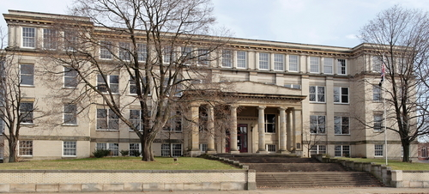
Physical Education
History
Chemistry
English
Computer Science
Subjects
biology
Physics
Literature
Music
Math
Geography
3:47

Slide 3
Theme 4
AT SCHOOL
B. The library
Lesson 4. B4
* New words:

Slide 4
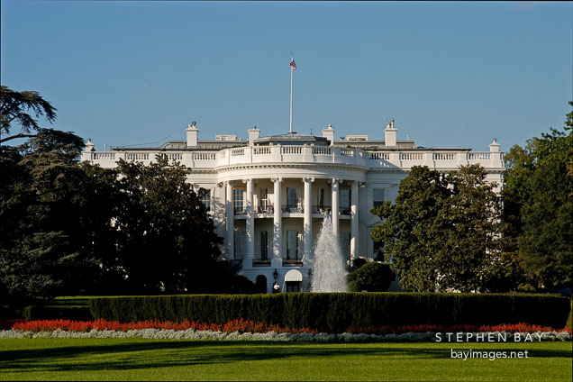
The White House. Washington, D.C., USA

Slide 5
I. Vocabulary
Congress (n)( The United
States of Congress)
Quốc Hội(Hoa Kỳ)
Capital(n)
thủ đô
receive (v)
nhận
copy (n)
bản sao
contain (v)
chứa
The White House. Washington, D.C., USA

Slide 6
Jumbled words
1. tianocn = ?
contain
2. pyoc = ?
copy
3. eicreve = ?
receive
4. plemoeey = ?
employee

Slide 7
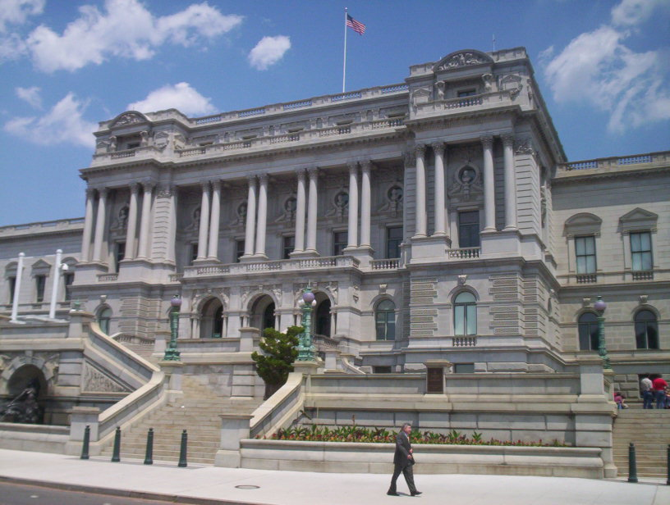
The Library of Congress

Slide 8
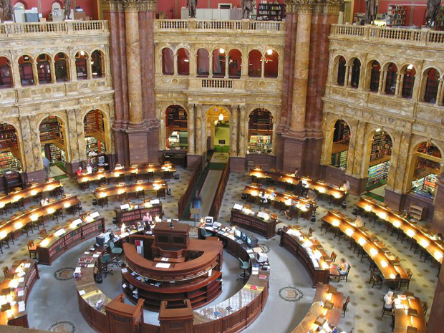
the reading room

Slide 9
The Library of Congress
One of the world’s largest libraries is the United State’s Library of Congress. It is in Washington D.C, the capital of the USA. It receives copies of all American books. It contains over 100 million books. It has about 1,000 km of shelves. It has over 5,000 employees.
True ( T ) or False ( F ) ?
The Library of Congress is in the capital of the USA.
T
b) The shelves are about 800 km long.
F
c) There are over 100 million books in this library.
T
d) It receives copies of all English books.
F

Slide 10
Read. Then answer :
Where is the Library of Congress?
How many books does it have?
How long are its shelves?
How many people work there?
Why is it so large?

Slide 11
ANSWERS:
a) Where is the Library of Congress?
- It’s in Washington D.C, the capital of the USA.
b) How many books does it have ?
- Over 100 million books.
c) How long are its shelves?
- About 1,000 km of shelves.
d) How many people work there?
- Over 5,000 people.
e) Why is it so large?
- Because it receives copies of all American books.

Slide 12
Homework:
1. Rewrite the answers in B4.
2. Describe your school library ( 6-8 sentences ).

